Slide 1

Experiential Learning
Project Assessment-III on
“Recruitment & HR Analytics Portal”
under the course
Python Programming Language (N-PCCCM304P)
Presented By
Gunjan R. Chimote
Under the Guidance of
Mrs. Mayuri Getme
Session:2026-27 (ODD )
Department of CSE(AI&ML)
S. B. JAIN INSTITUTE OF TECHNOLOGY MANAGEMENT AND
RESEARCH,NAGPUR
An Autonomous Institute, Affiliated to RTMNU, Nagpur
)

Slide 2
Contents
Problem statement
Objectives
Algorithm
Flowchart/pseudocode
Understanding of Python logic
GitHub account, repository creation, uploading code, meaningful commits, collaboration, individual contribution
S. B. Jain Institute of Technology Management and research

Slide 3

Problem Statement
Project Title
Recruitment & HR Analytics Portal
(Phase 2)
Project Description
A Python-based HR management system that manages job applications, candidate information, interview schedules, employee recruitment, and generates HR analytics reports to support effective hiring decisions.
S. B. Jain Institute of Technology Management and research

Slide 4
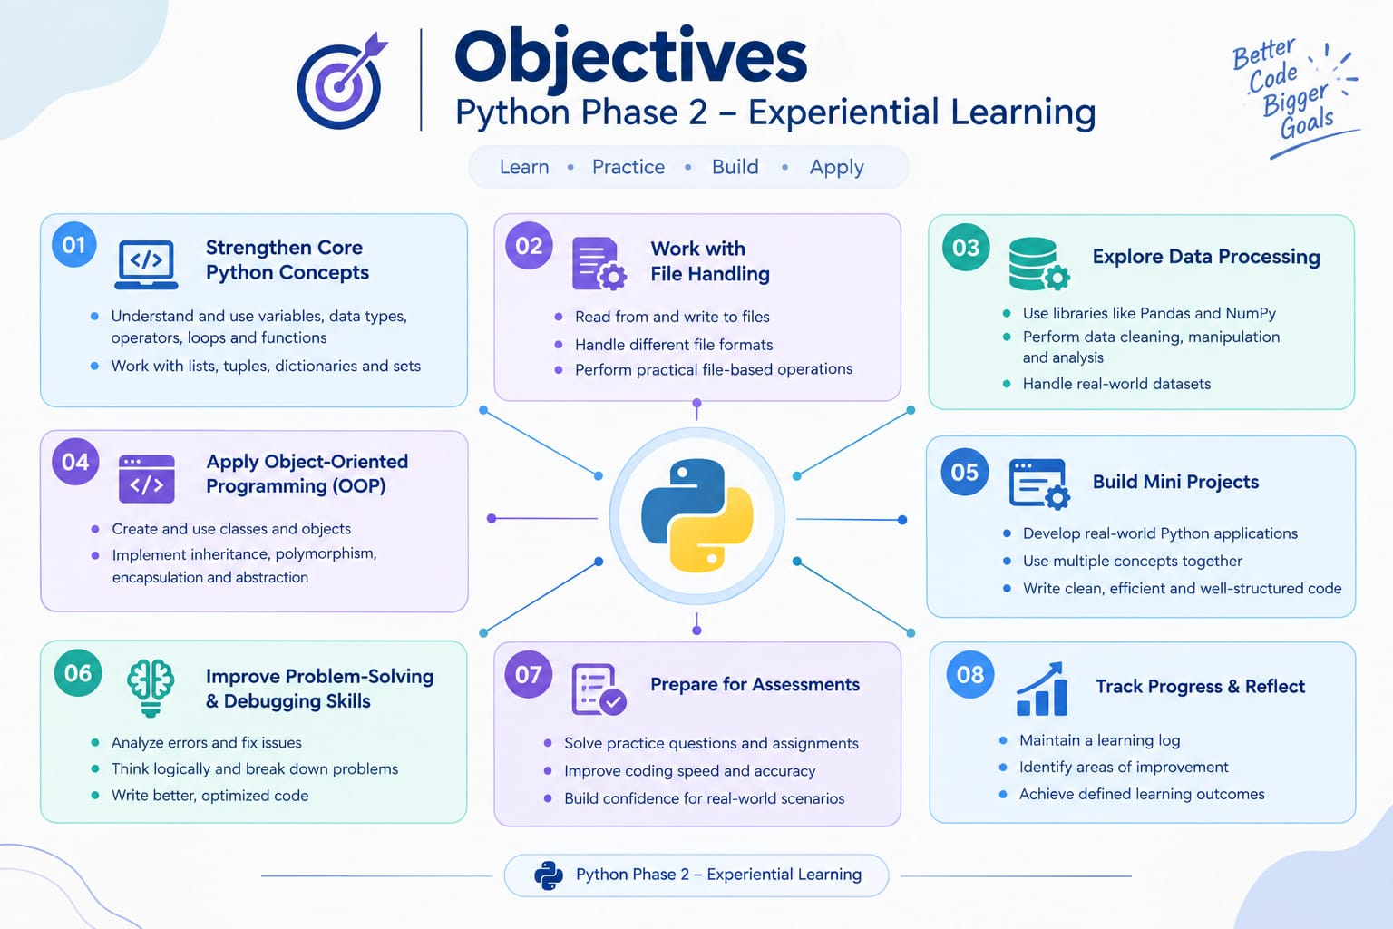
Objectives
🎯
Automate and simplify end-to-end recruitment workflows, reducing manual effort and administrative overhead.
📊 Efficient Management
Manage jobs, candidates, applications, and interview schedules efficiently from a single portal.
📈 Data Analytics
Analyze recruitment data using advanced data-processing techniques and machine-learning models.
💡 Visual Insights
Provide rich visual HR insights via interactive charts to support smarter, data-driven hiring decisions.

Slide 5
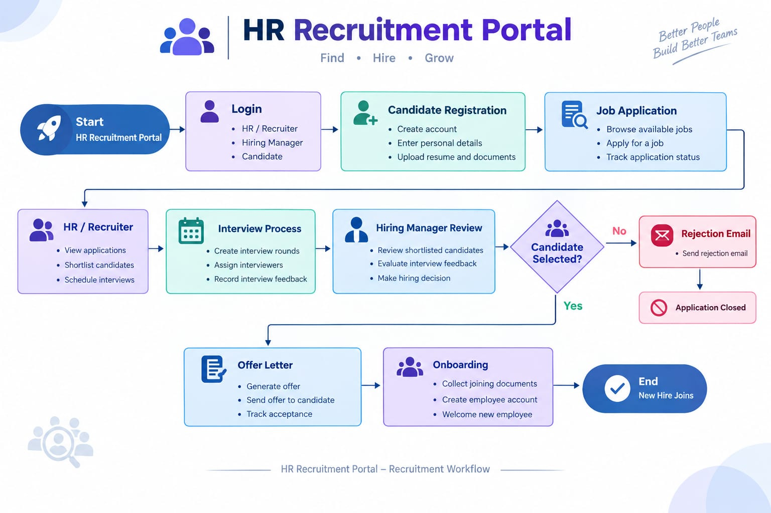
Algorithm

Slide 6
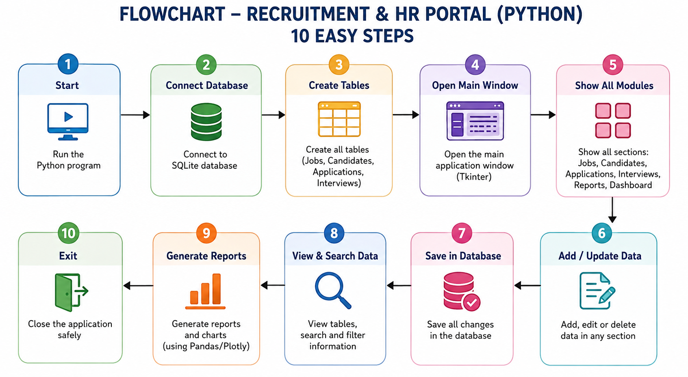
Flowchart

Slide 7
Understanding of Python Logic
Relational Database Management : Creates structured tables (jobs, candidates, applications, interviews) with foreign key constraints to enforce data integrity and avoid redundancy.
Dynamic UI Routing & Execution (Streamlit): Uses sidebar navigation to route execution flow and triggers st.rerun() to refresh the app state immediately after database updates.
Data Input & Format Validation: Uses Regex (re) and datetime functions to validate email syntax, date, and time inputs before committing entries to the database.
Data Analytics & Visualization (Pandas & Plotly): Processes raw SQL query results into Pandas DataFrames to generate real-time metrics, pipeline funnels, and distribution charts.
Interactive Editing & Export: Enables inline table updates by comparing edited DataFrames to source data and encodes reports using Base64 for one-click CSV downloads.

Slide 8
GitHub
Created a dedicated GitHub repository for the Experiential Learning project.
The repository is used to upload and maintain the complete project code and related files.
Built data processing pipeline using Pandas & NumPy
Developed HR analytics visualizations with Plotly & dashboard in Streamlit

Slide 9
Thank You
S. B. Jain Institute of Technology Management and research

